Slide 1

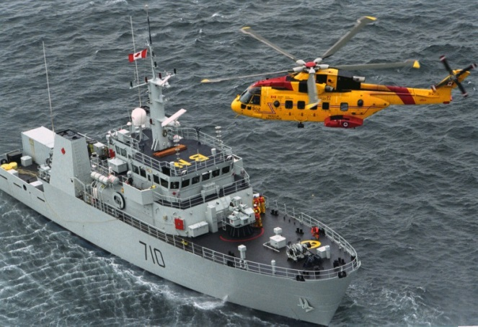
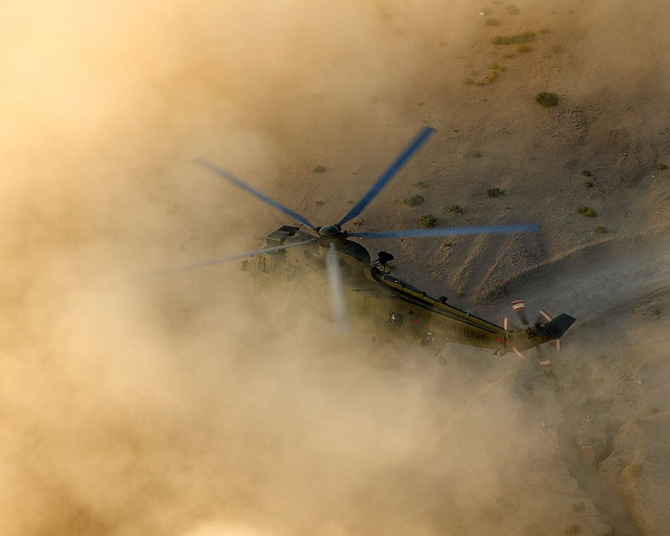

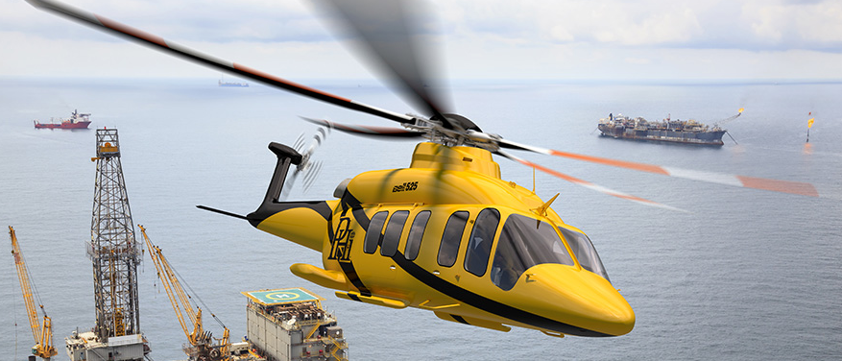
American Helicopter Society (AHS) International.
Notes:
Clockwise:
[1] AgustaWestland. “Heroic Night Time icy Arctic sea search and rescue mission awarded with trophy for Helicopter Rescue”. 2011. Photograph. http://theaviationist.com/2012/10/09/helicopter-rescue/
[2] Merrill, Mez. “A Sea King helicopter with 845 Naval Air Squadron experiences a 'brownout' in while landing in the desert”. 12 Aug 2013. British Royal Navy.
[3] “Computer generated impression of the soon to be Bell 525 Relentless.” 2014. Image. Bell Helicopter Textron. http://airheadsfly.com/tag/bell-525/

Slide 2
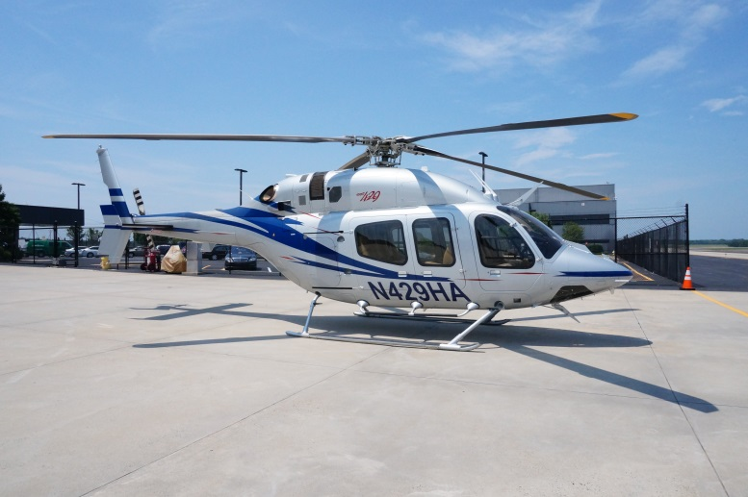

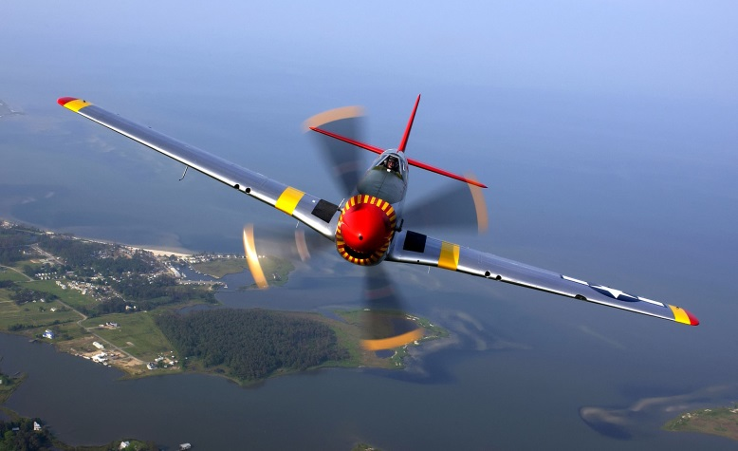
Helicopters vs. Airplanes
What only helicopters can do
vs.
Only helicopters can hover and move backwards!
AHS INTERNATIONAL
Notes:
Clockwise:
[1] Nayak, Iwin. “Paramedical Helicopter flying backwards”. Online video clip. Youtube. 10 Apr 2010. Web. 01 Jan 2016.
[2] Chen, Betty. “N429HA”. 2016. Photograph. AHS International, Dulles, Virginia.
[3] Bloker, Ben. “Over Virginia. Ed Shipley flies a P-51 in a heritage flight during an air show at Langley Air Force Base”. 21 May 2004. Photograph. US Air Force. Langley Air Force Base, Virginia.

Slide 3


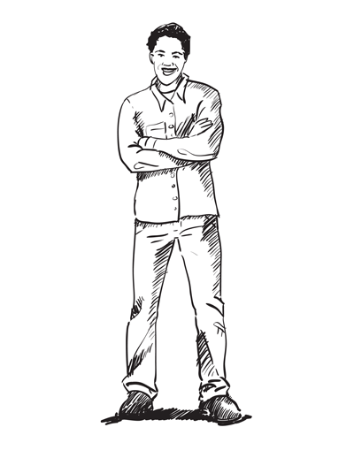

Acceleration
  position
  current location
  velocity
  change in position
  acceleration
  change in velocity
AHS INTERNATIONAL

Slide 4

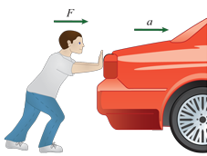
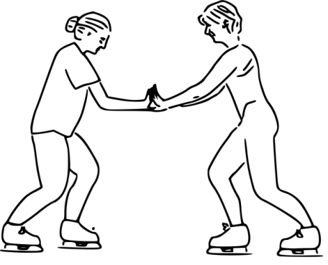
Force has strength and direction.
Isaac Newton
Newton’s 2nd Law: Force = mass × acceleration
Newton’s 3rd Law: Every action has an equal and opposite reaction
AHS INTERNATIONAL

Slide 5
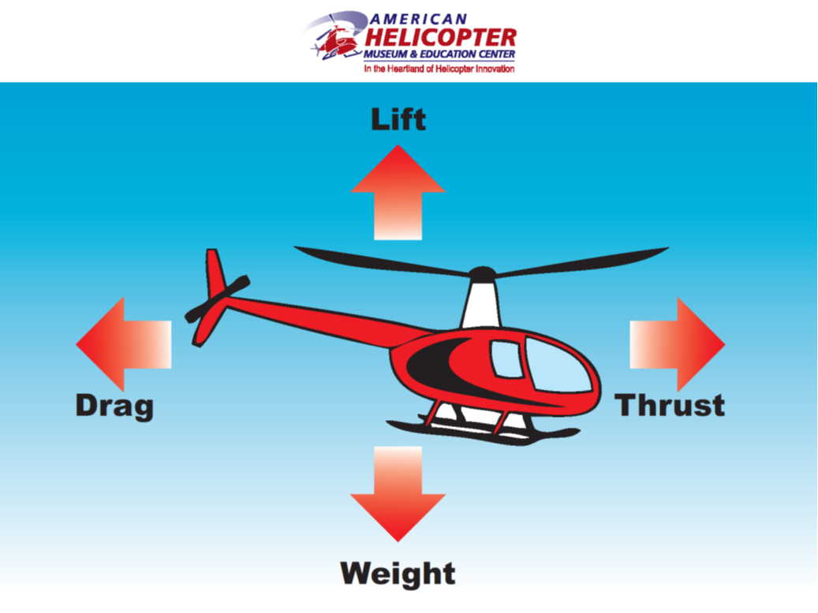
Forces of Flight
Notes:
Diagram from the American Helicopter Museum & Education Center (West Chester, Pennsylvania)

Slide 6



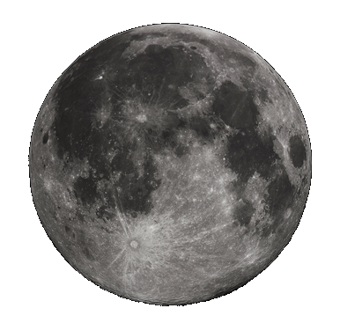
Acceleration due to Gravity
?
?
Where is Taylor going to fall down faster?
On EARTH! The fall is about 6 times faster on Earth than on the Moon!

Slide 7


Suggested slide: Prof. Celi demoed this at a recent AHS STEM outreach with good responses from students
Notes:
Cut out a long, thin strip of paper. Hold it under your lips with two hands and blow across the top. What will happen?

Slide 8
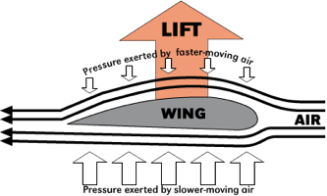
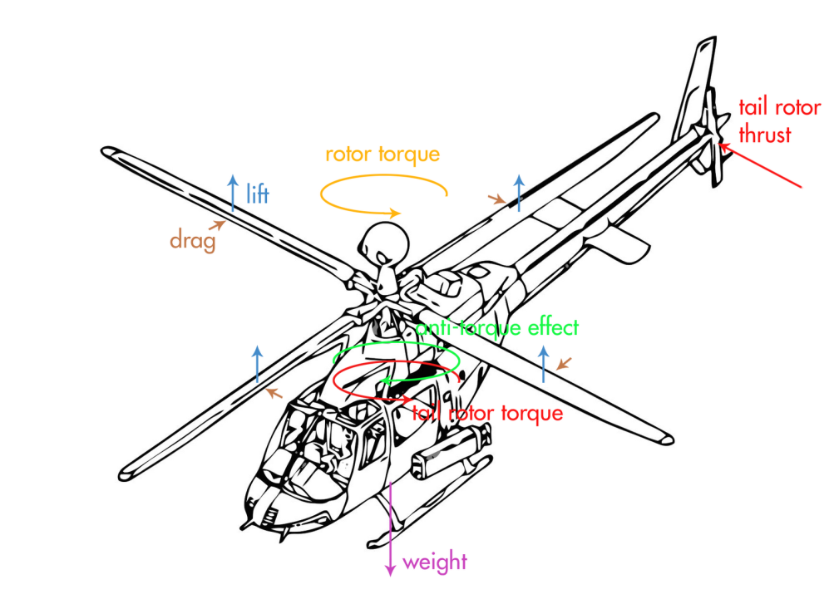
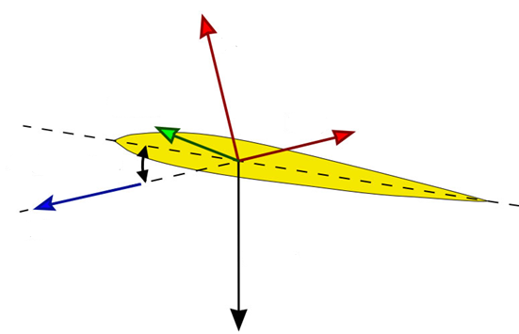
How Lift is Created

Slide 9
Forces of Flight
Notes:
Diagram from the American Helicopter Museum & Education Center (West Chester, Pennsylvania)

Slide 10
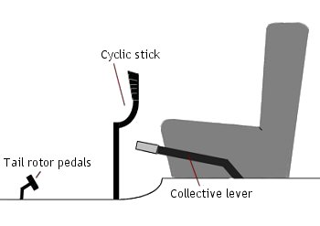
Standard Helicopter Flight Controls
Tilts helicopter forward, backwards and side to side
Controls direction
Makes helicopter go up
Involves both hands and both feet!
AHS INTERNATIONAL

Slide 11
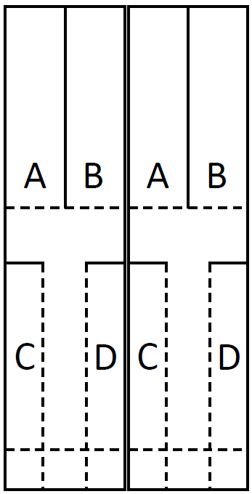
Paper Helicopter Construction
Fold along dotted lines
A
B
C
Step 1
D
A
B
C
D
Step 2
A
B
Step 3
C
D
Paper Helicopter Template
AHS INTERNATIONAL
Notes:
Paper Helicopter Construction: (Some example helicopters will be already pre-assembled to support the demonstration)
Obtain the paper helicopter template. Cut along the solid lines only and fold along the dotted lines. If you want, you can use crayons or markers to color your paper helicopter before you fold it. The colors will blur together when it spins.
Fold “A” towards you. (See Figure 1)
Fold “B” away from you. (See Figure 1)
Fold “C” and “D” over each other so that they overlap. (See Figure 2)
Fold the bottom up (along the dotted line) and put a paper clip on it. (See Figure 3)

Slide 12
Paper Helicopter Demo Flight
Launch paper helicopter and observe during “flight”
A
B
A
B
C
D
C
D
AHS INTERNATIONAL
Notes:
Paper Helicopter Demonstration Flight: (Student Volunteers will be selected to demonstrate)
Hold the constructed paper helicopter by the paper clip.
Throw it like a baseball, as high and far as you can and allow it to spin to the floor.
Alternatively, you can also stand on a chair or on the stairs and drop it towards the floor.
Notice the direction that the paper helicopter is spinning during flight
OPTIONALLY: Add a second paper clip to the bottom of the helicopter. “Fly” the helicopter again.
OPTIONALLY: Bend the “A” and “B” blades in opposite directions. “Fly” the helicopter again.

Slide 13
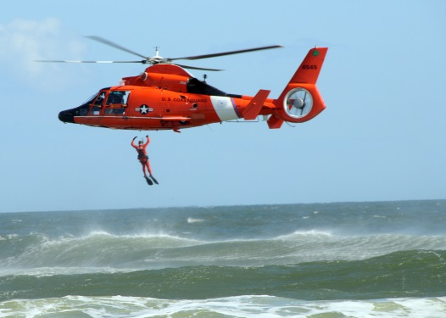
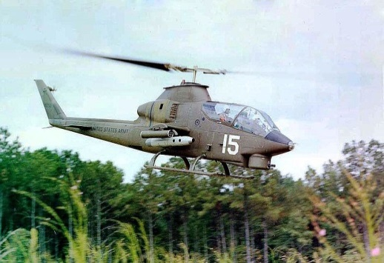
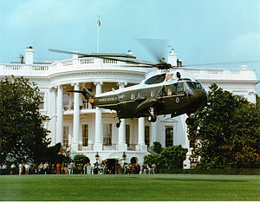
Helicopter Missions
Search and Rescue
Training
Military
Executive Transport
AHS INTERNATIONAL
Notes:
Sikorsky VH-3D Presidential Sea King aka Marine One (https://lh3.googleusercontent.com/-jIBCqQ0iGg4/VBqZ72pBDPI/AAAAAAAAF9g/cjGyCUVrvYo/w747-h582-no/VH-3D%2BM1.jpg)

Slide 14
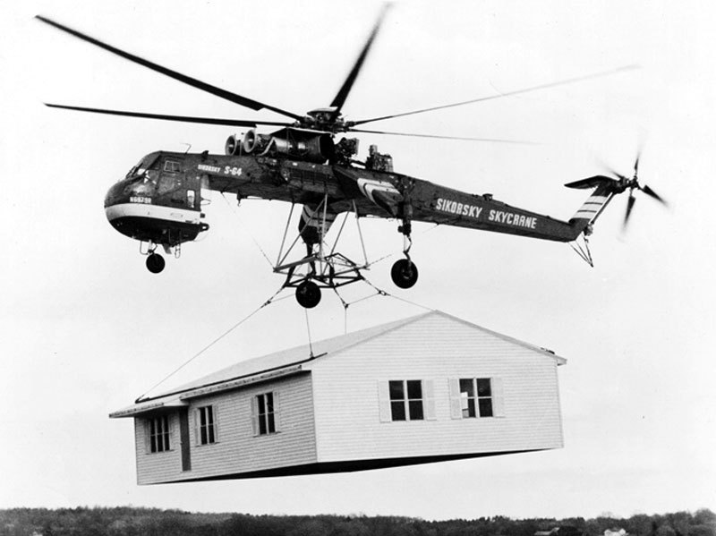
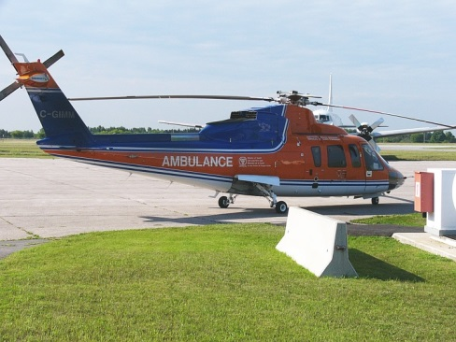
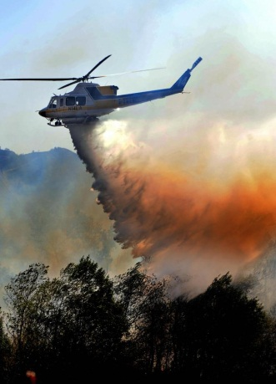
Helicopter Missions
Construction
Medical evacuation
Firefighting
And lots more!
AHS INTERNATIONAL

Slide 15
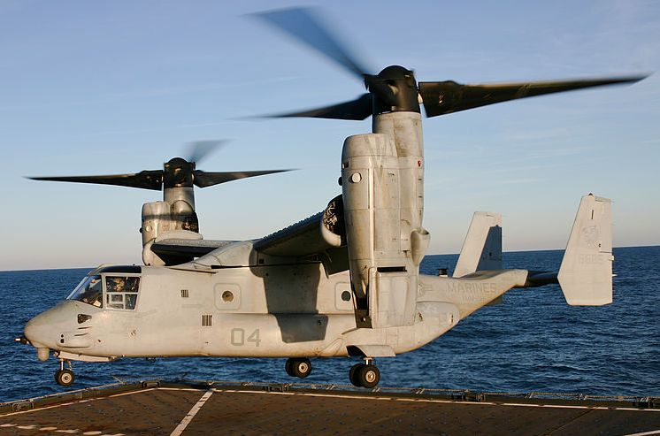
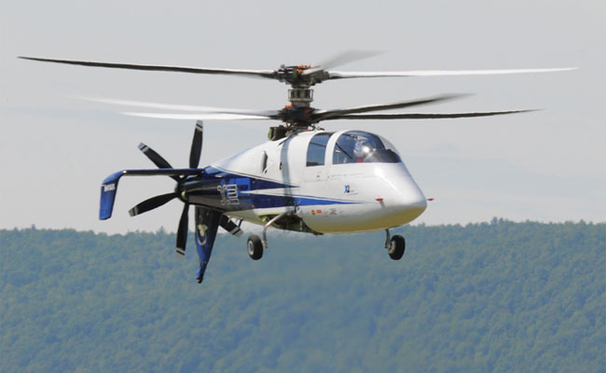
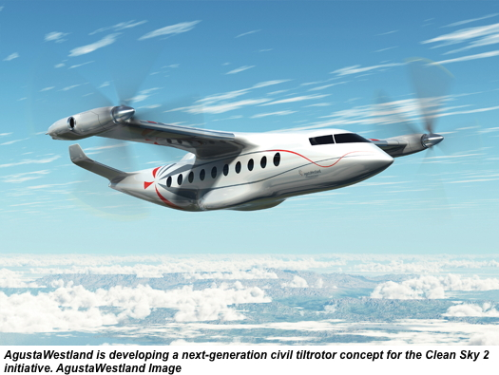
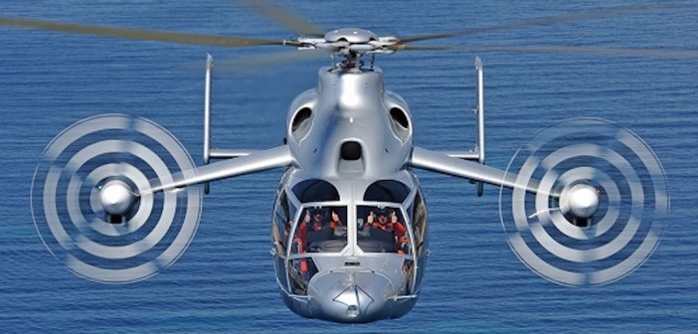
Unique VTOL Aircrafts

Slide 16
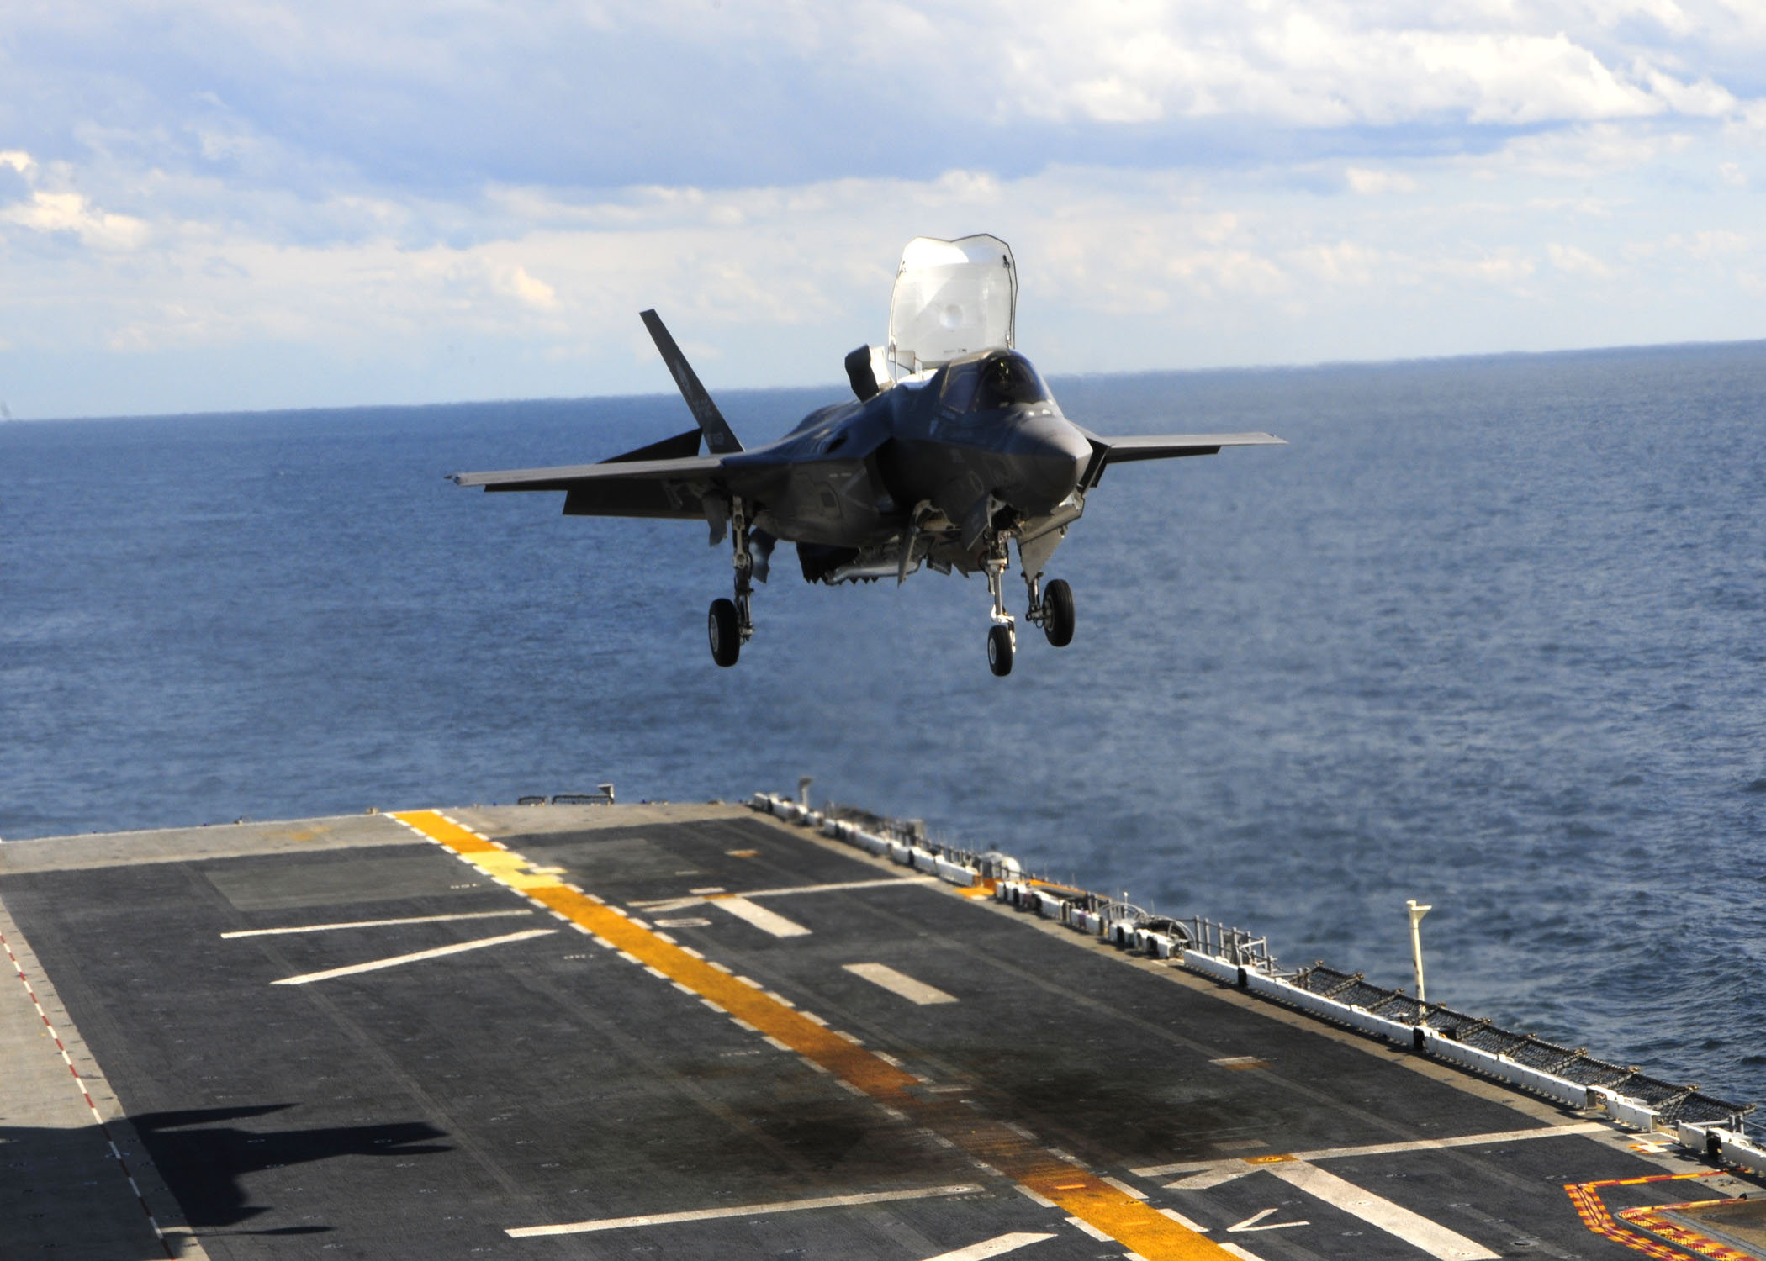
First supersonic STOVL stealth aircraft
F-35 B Lightning II
AHS INTERNATIONAL
Notes:
F-35B Lightning II, first supersonic STOVL stealth aircraft
Chalk, Natasha R. 3 Oct 2011. Photograph. US Navy. http://www.navy.mil/view_image.asp?id=108223.

Slide 17
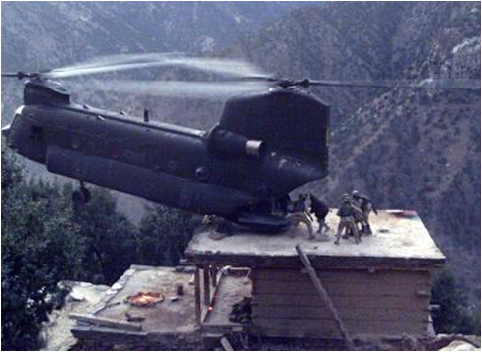
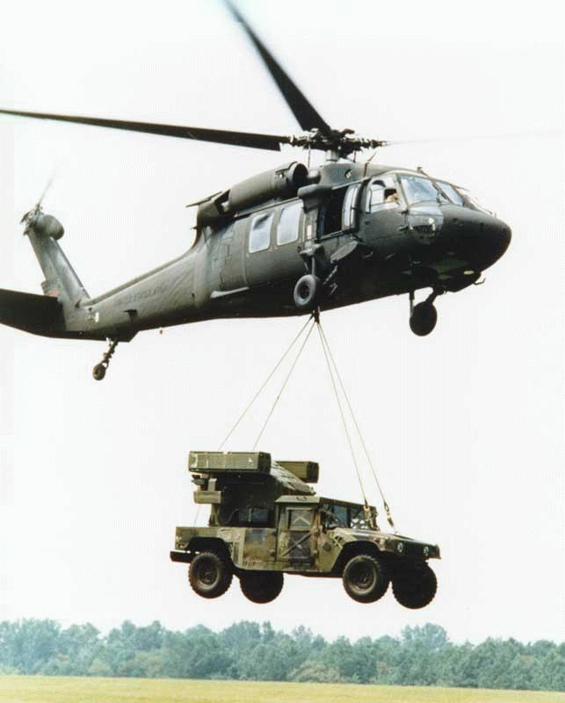
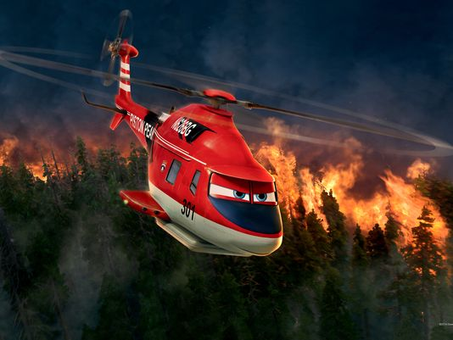
Why are helicopters unique?

Slide 18
Important Information
Airfoil: The distinct shape of the wing of an airplane or the rotor blades of a helicopter
Angle of Attack: The angle of the airfoil, using the body of the aircraft as a reference point.
Pressure: The force exerted on an object
Velocity: The speed at which and object is travel at
Gravity on Earth: 9.807 m/s²
Gravity on the Moon: 1.622 m/s²
AHS INTERNATIONAL

Slide 19
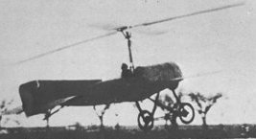
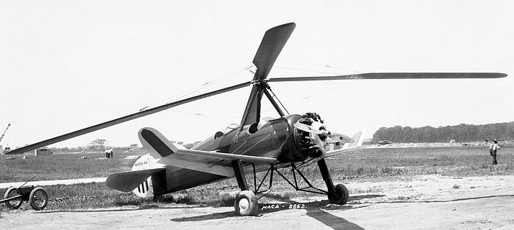
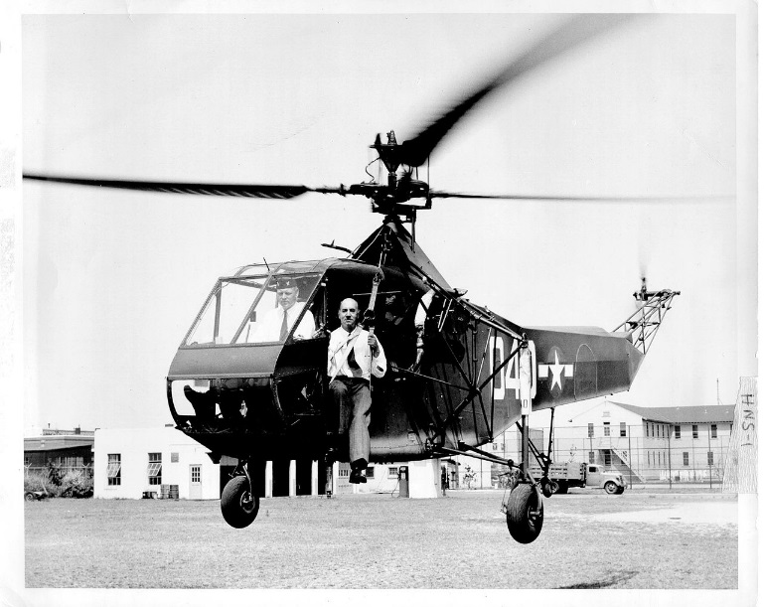
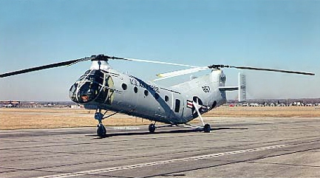
Evolution of the Rotary Wing
1923 Ciervas Autogiro
1931 Pitcairn Autogiro
1943 Sikorsky R-4
1952 Piasecki CH-21B
AHS INTERNATIONAL
Notes:
In the early 1920’s De la Cierva demonstrated flight in an Autogiro which used a rotating wing (rotor) to obtain lift
During the 1930’s Pitcairn continued the Autogiro development in a joint initiative with Cierva
As the US entered the 2nd World War, interest in the Autogiro disappeared as the demand for fixed-wing aircraft increased rapidly
Frank Piasecki began his effort in developing Helicopters which lead to the H-21, CH-46, CH-47 etc

Slide 20
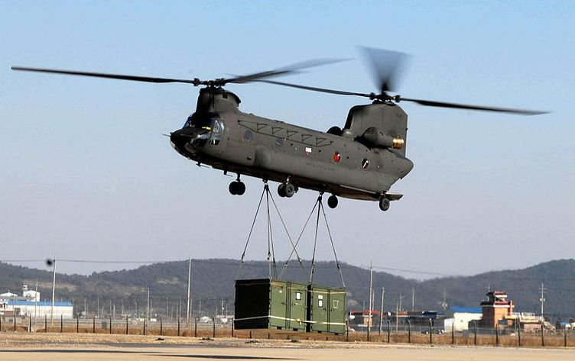
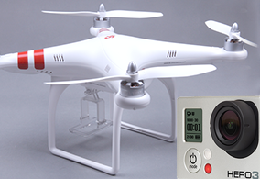
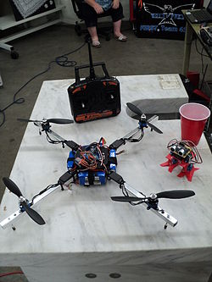
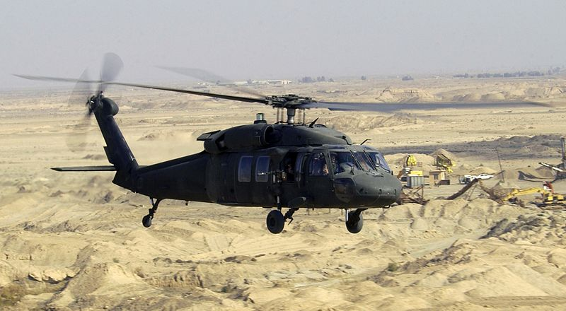
ROTORCRAFT:
PRESENT & FUTURE
AHS INTERNATIONAL

Slide 21
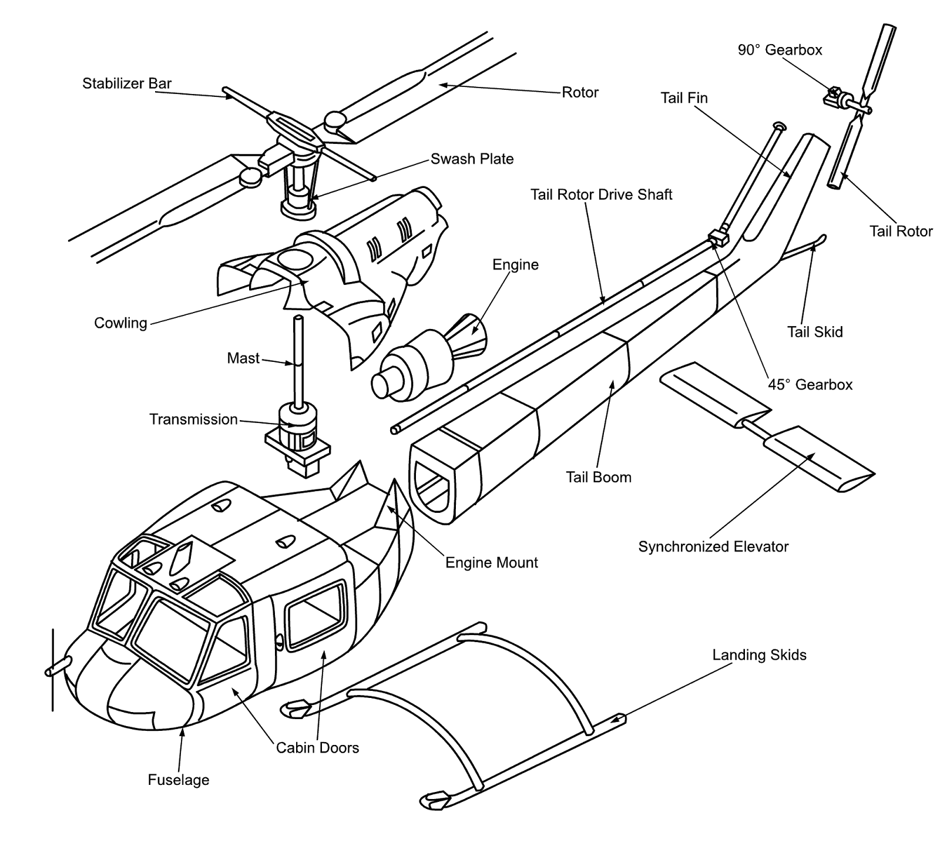
Main Parts of the Helicopter
AHS INTERNATIONAL
Notes:
http://cursodeinglesbh.blogspot.com/2010/12/parts-of-helicopter.html

Slide 22
“Making Better Helicopters”
Susan Gorton, NASA Langley Lead
AHS INTERNATIONAL

